Slide 1
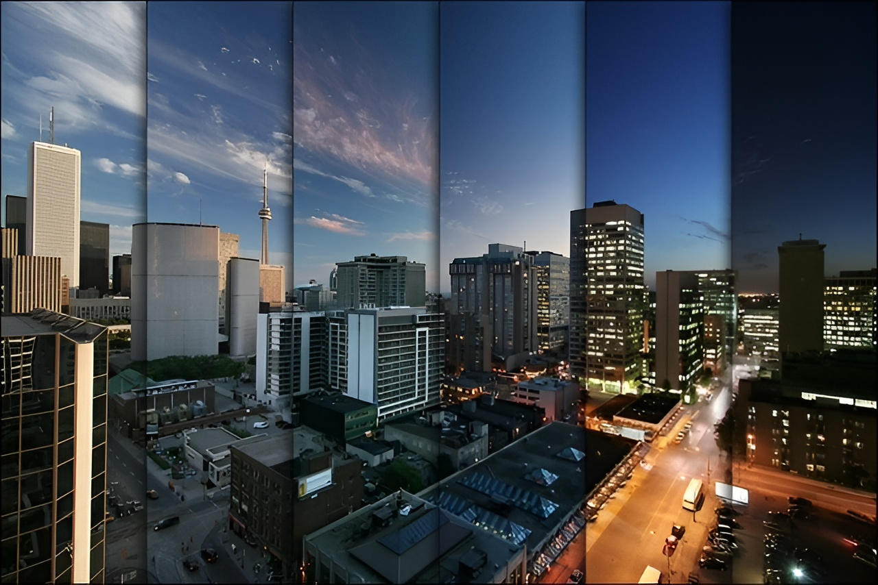
Time-Lapse Video Synthesis
from a Single Outdoor Image
By: Dao Quang Tung, Nguyen Duc Khoa

Slide 2
Introduction & Problem
Time-lapse videos are visually captivating, showcasing the passage of time through drastic color and motion changes. However, their creation is often:
Difficult & Costly
Requires sophisticated hardware and significant time for capture and editing.
It is helpful to design and develop a system to facilitate the creation of time-lapse videos.

Slide 3



Introduction & Problem
Previous data-driven methods often require a reference video, which has significant limitations:
Storage & Retrieval
Semantic Mismatch
Reference Dependency
Older methods need to store entire video databases for retrieval at runtime.
Difficulty finding reference videos semantically similar to the input image.
Most deep video generation techniques still require a reference video or label map sequence.

Slide 4
Related work
1. Image & Video Stylization
Previous work: Focused on transferring an image from a source domain to a target domain (e.g., day to night, sketch to photo) while preserving the content.
Approach in this work: Instead of a discrete domain transfer, our method creates a continuous change in illumination. They use the time of day as a control variable in a conditional generative model.
2. Animation Still Images
Previous work: The most related method is a data-driven approach that creates time-lapses by finding a reference video in a large database to guide the color transfer.
Limitation: This requires storing an entire video database at runtime and may fail if no semantically similar reference video can be found.
Approach in this work: Only requires storing a compact model and needs no reference video at runtime, making our approach more robust and efficient

Slide 5
Related work
3. Learning from Video Datasets
Previous work: This line of research focuses on analyzing time-lapse videos to extract rich information, such as illumination, materials, geometry , or to learn intrinsic image decomposition.
Approach in this work: Draw inspiration from this research, they propose to learn a generative model to synthesize time-lapse videos from a single image

Slide 6
Main Contributions
Motivated by the limitations of existing time-lapse video generation methods, the authors propose a solution that synthesizes time-lapse videos from a single input image, making three key contributions:
1
2
Multi-frame joint conditional generation
3
First solution
Multi-domain training
Synthesizing a time lapse video with continuous and photorealistic illumination changes from a single image without reference video
Learn the distributions of color tones at different times, bypassing the motions and outliers in the training data
Stable semi-supervised learning from different datasets to improve the visual quality

Slide 7
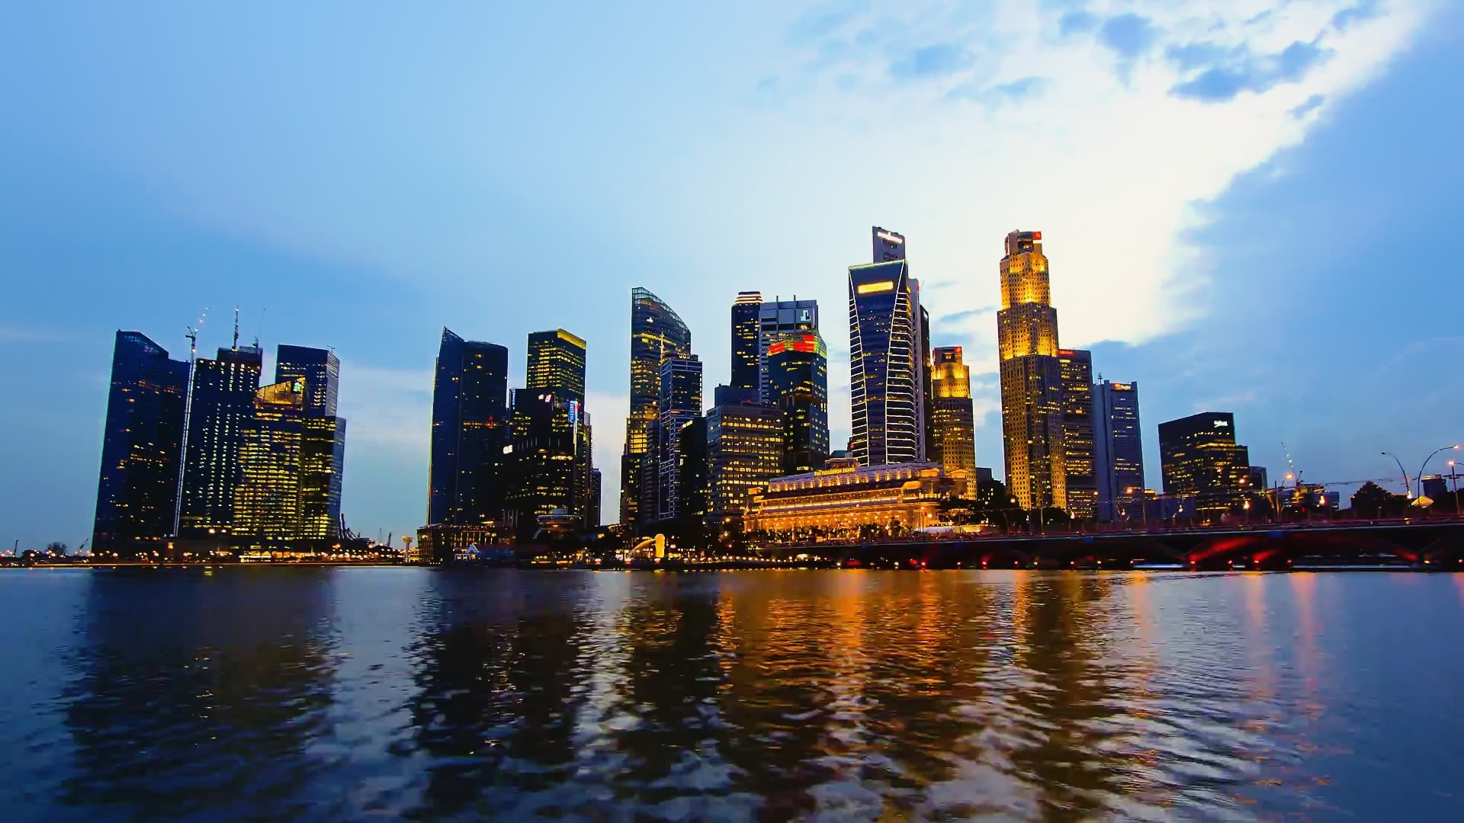
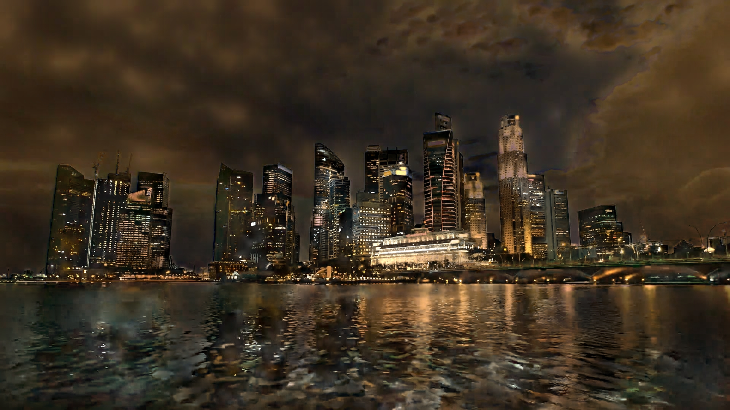
Method Overview
Main task: Conditional image translation based on GANs by using the time of day as the conditional
variable..
I
Ĩ_{t}
G(I, t)

Slide 8
Method Overview
Schematic diagram of time-lapse video generation
Ĩ₀
Ĩ₁
I
G(I, t)
Aggregate
Ĩ₀
Ĩ₁
Ĩ_{n}
Video time-lapse
Ĩ_{n}

Slide 9
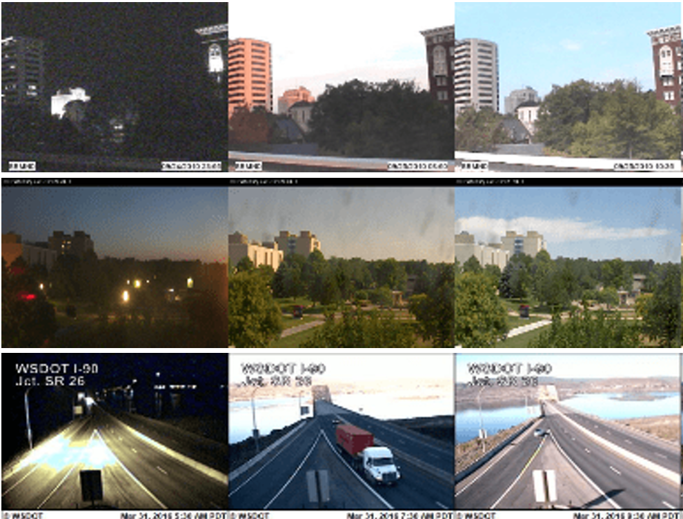
Method Overview
Dataset
AMOS Dataset (Archive of Many Outdoor Scenes)
Source: A large-scale dataset of outdoor image sequences, captured from over 35,000 webcams around the world.
A typical sequence in AMOS has tens of frames for every 24 hours.
Each image has a timestamp label

Slide 10
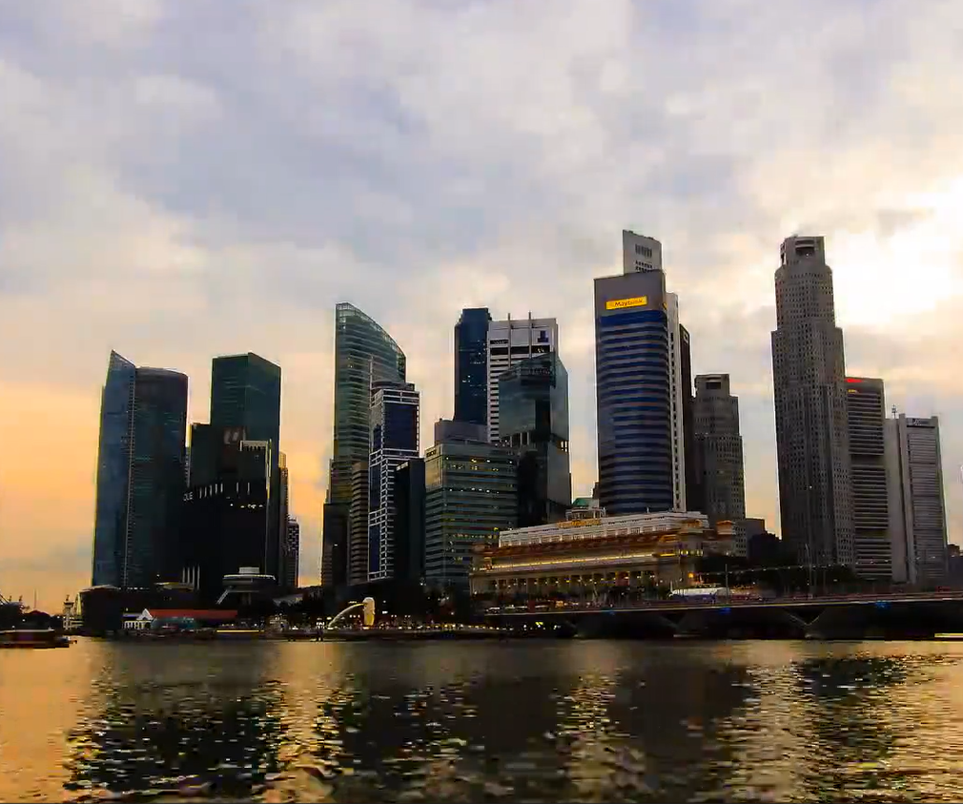
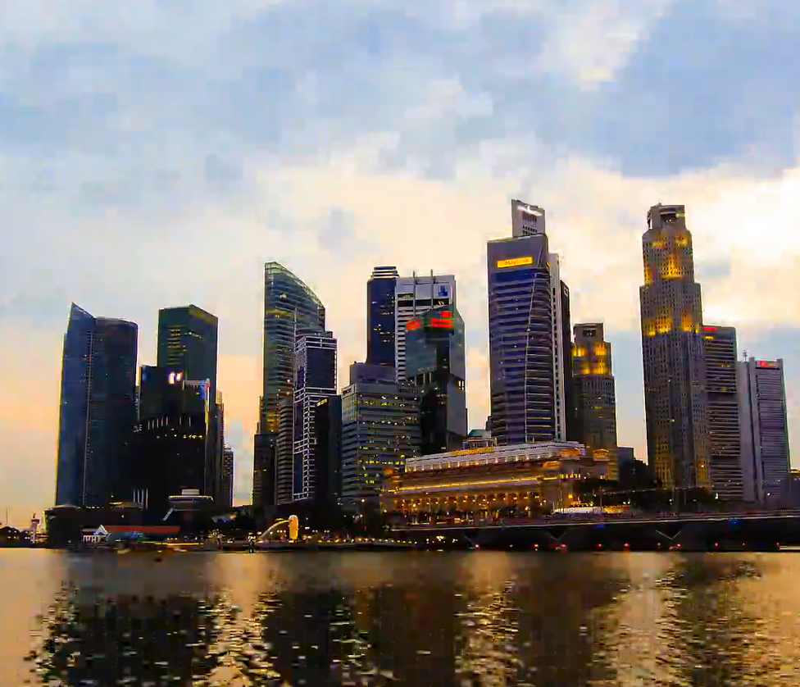
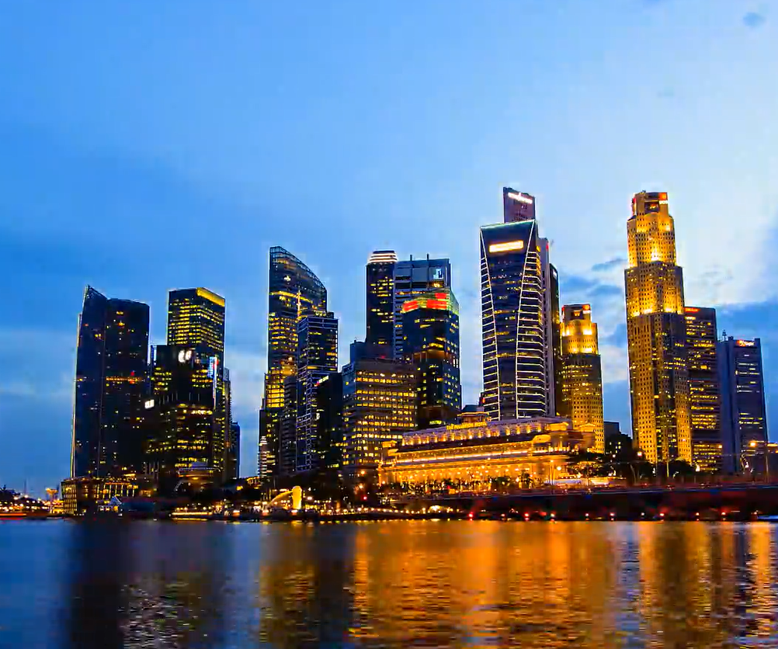
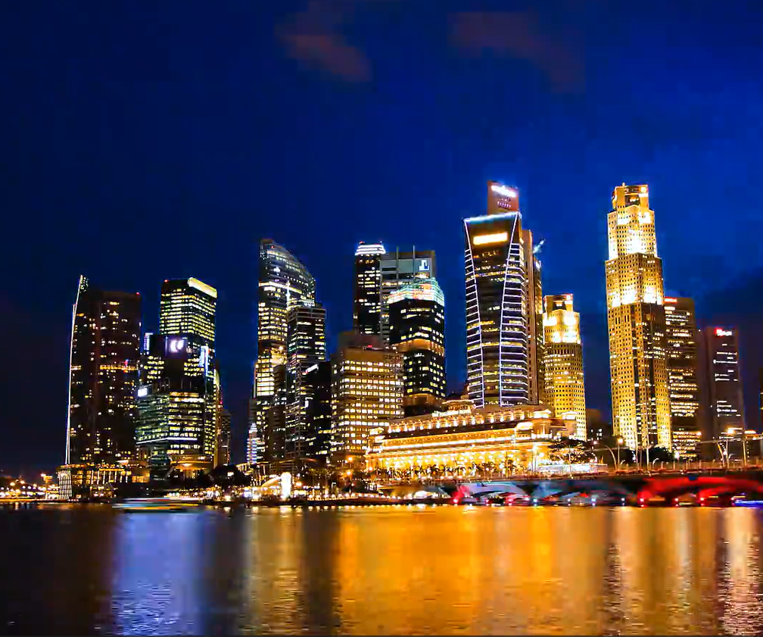
Method Overview
Dataset
TLVDB Dataset (Time-Lapse Video Database)
Source: Consists of 463 real time-lapse videos, mostly of landmark scenes with high visual quality.
Each video has at least hundreds of frames.
These videos do not have timestamp labels for each frame.

Slide 11
Method Overview
Contribute 1: Multi-Frame Joint Conditional Generation
The Challenge: Training the model on individual frames independently tends to generate implausible color tones in the output sequence. This is because the illumination at a specific time t is correlated with illuminations at other times of the same day.
The Solution:
Train the model using multiple frames from the same sequence at once to learn the correlation and overall context of an entire day

Slide 12
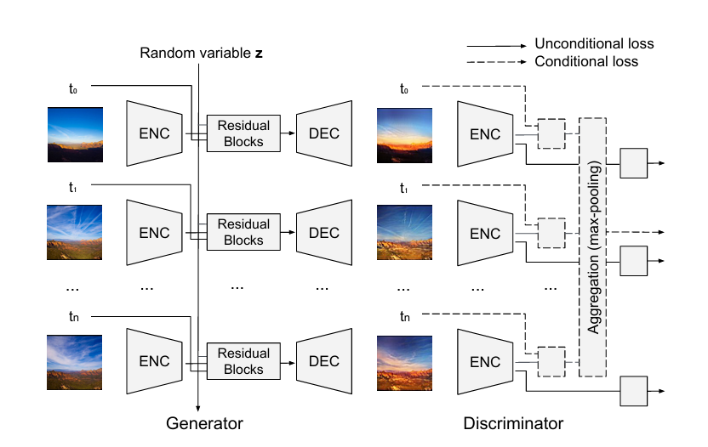
Method Overview
Contribute 1: Multi-Frame Joint Conditional Generation
Generator:
Simultaneously processes n frames from the same training sequence.
Use this latent variable z as the temporal context of each sequence to learn the joint distribution of color tones at different times of the day
Discriminator:
Performs two tasks:
Is each image realistic? (Unconditional loss).
Is the entire sequence temporally plausible? (Conditional loss).

Slide 13
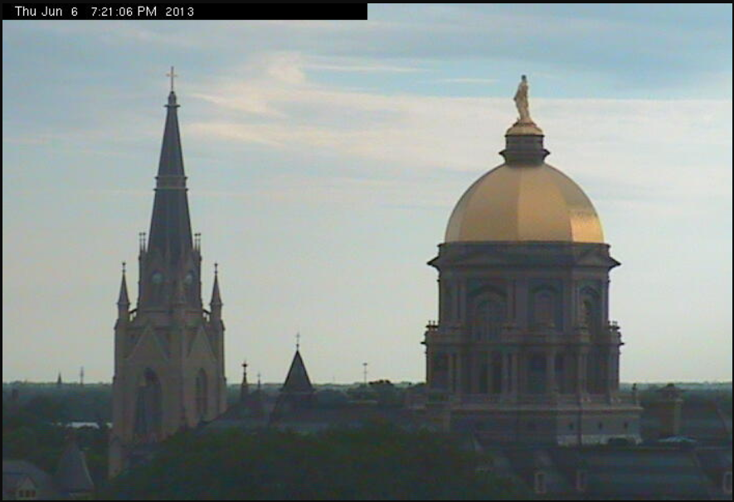
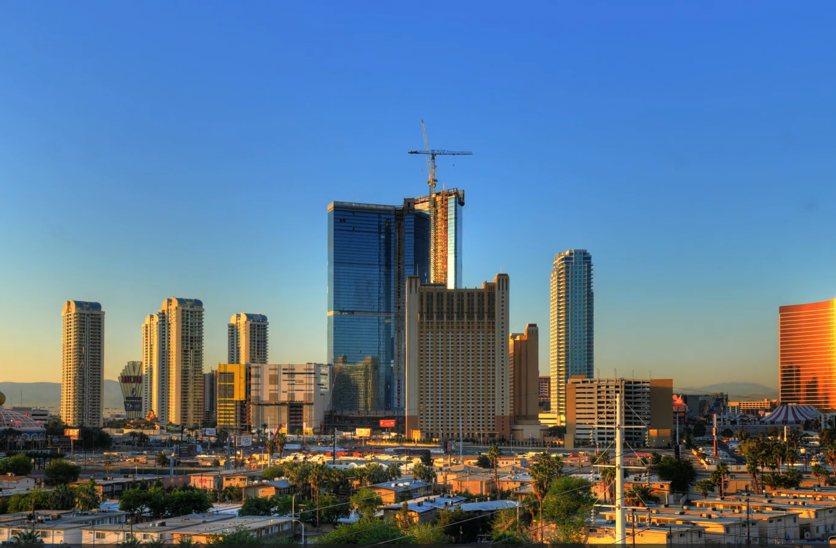
Method Overview
Contribute 2: Multi-Domain Training
AMOS Dataset
Large-scale, but often visually uninteresting surveillance camera footage with timestamps.
TLVDB Dataset
High-quality, visually rich time-lapse videos, but lacks ground-truth timestamps.

Slide 14
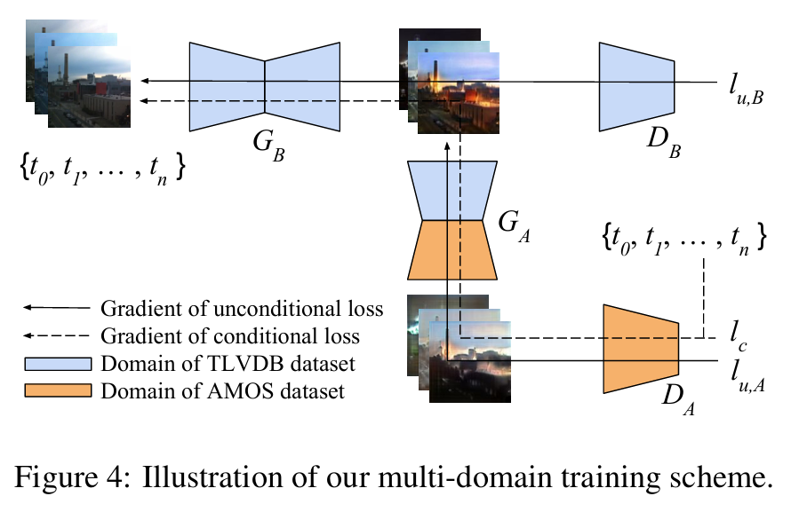
Method Overview
Contribute 2: Multi-Domain Training
Key idea:
Synthesize time-lapse sequences using the TLVDB dataset
Learn continuous illumination changes over time from the AMOS

Slide 15
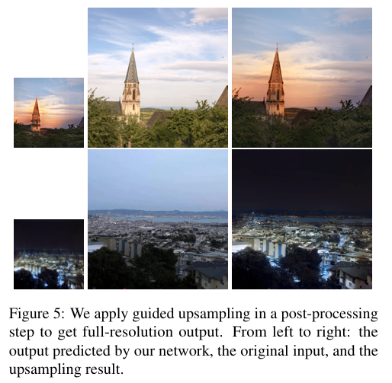
Guided Upsampling
Since our training data is very limited and contains lots of noise, it is difficult to train the network to directly output full-resolution results.
Therefore, we first train the generative network to predict an output at a lower resolution. Then, we apply an automatic guided upsampling approach to obtain the full-resolution result.

Slide 16
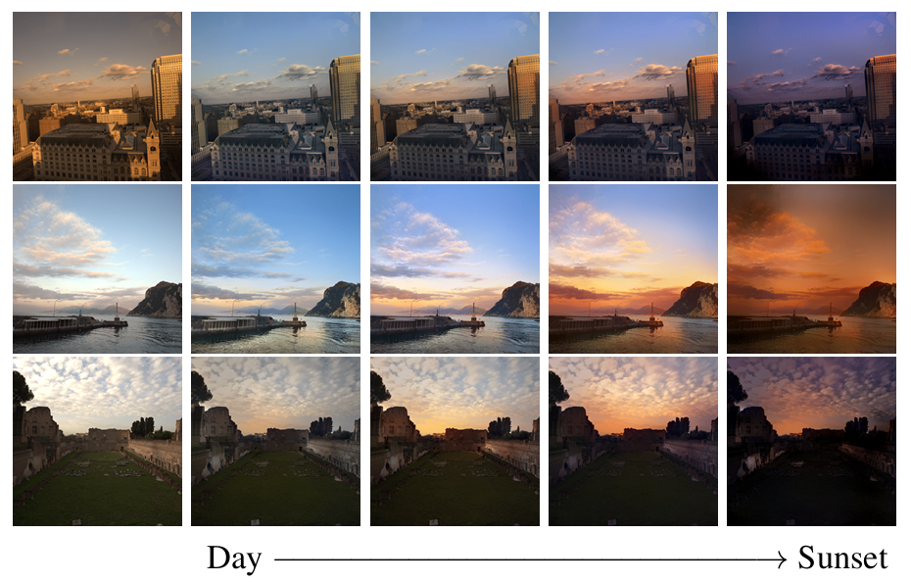
Experiments Result
Quantitative results
User study
 | Real vote
Real Image | 67.5%
This method | 60.6%
Li method | 34.1%
Shih method | 44.9%

Slide 17
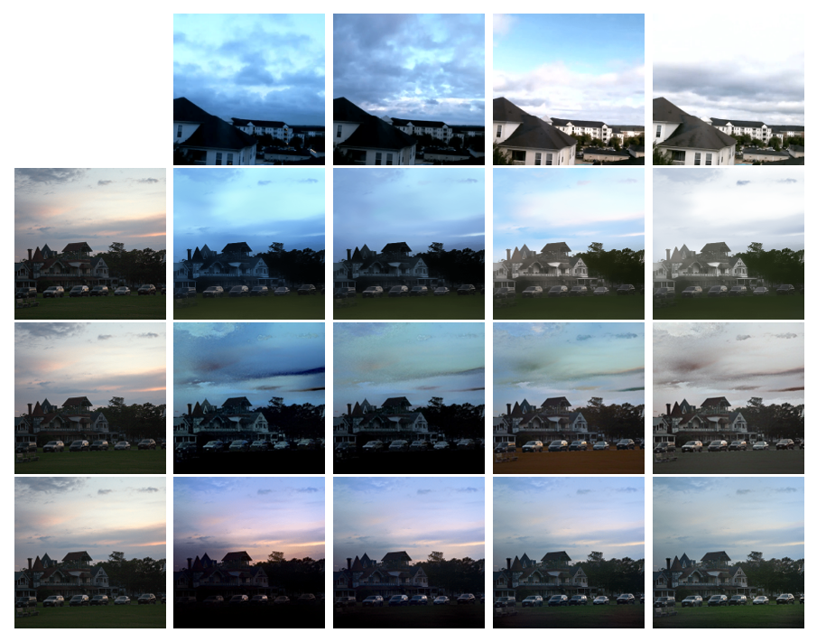
Experiments Result
Reference video
Quanlitative results
Comparison with baselines:
Baselines rely on reference videos → prone to unrealistic results when scenes differ.
Often produce unnatural colors and visual artifacts.
Proposed method:
Works without reference videos
Generates plausible illumination and color changes over time.
Li method
Shih method
This method

Slide 18
Experiments Result
Computation time
At inference time, we only need Gb to synthesize time-lapse videos
Method | Input Resolution | Device | Time
Gb | 512x512 | GPU | 0.02s
Gb | 512x512 | CPU | 0.8s
Guided Upsampling | 512x512 | CPU | 0.1s
Shih Method | ~700 px width | CPU | 58s
Li Method | 768x384 | GPU | 6.3s
Suitable for deloyment on mobile devices.

Slide 19
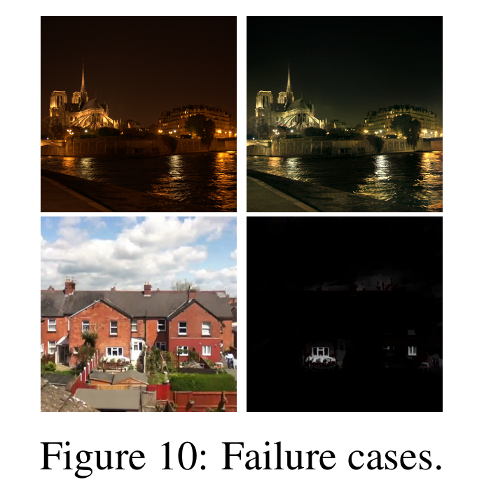
Conclusions
Limitations:
Struggles to hallucinate daytime images from very dark nighttime inputs
It sometimes fails to generate artificial lighting in regions like building windows.
It only changes color tones and does not introduce any motion, such as moving objects or clouds.

Slide 20

Conclusions
Future Works:
Improve the current approach to address the aforementioned limitations.
Combine the current approach with motion synthesis techniques.
Extending to additional semantic controls (e.g., sunrise/sunset times).

Slide 21
Thank you for listening

